Slide 1
GOOOOOALS! (101)
IN THIS WORKSHOP YOU WILL:
DEFINE GOALS
IDENTIFY THE CRITERIA FOR SMART GOALS AND APPLY THIS CRITERIA TO YOUR OWN ENRICHMENT PURSUITS
IDENTIFY OBJECTIVES IN ORDER TO ACHIEVE GOALS
RECOGNIZE HOW EVERYDAY DECSIONS EFFECT GOALS
Notes:
Through this workshop students will be able to…
DEFINE GOALS
IDENTIFY THE CRITERIA FOR SMART GOALS AND APPLY THIS CRITERIA TO THIER OWN ENRICHMENT PURSUITS
IDENTIFY OBJECTIVES IN ORDER TO ACHIEVE GOALS
RECOGNIZE HOW EVERYDAY DECSIONS EFFECT GOALS
ICE BREAKER
FUN NAME GAME
Have everyone sit in a circle. One person begins by giving their name, plus an adjective that begins with
the first letter of their name. (e.g., Jolly Jim, Happy Holly). The next person repeats the person’s name
and adjective and then their own name the same way. Continue around the circle.

Slide 2
ICE BREAKER
Notes:
Pass around bucket of colorful cut out paper
Tell everyone to choose anywhere from 1-5 pieces of colored paper
On board or chart paper write:
Red: Favorite Hobbies
Green: Favorite Place on Earth
Blue: Favorite Memory
Yellow: Dream Job
Orange: Wild Card – tell us anything about yourself!

Slide 3
GOALS…
What are they?
Notes:
*ASK FIRST AND WRITE ANSWERS ON THE BOARD
Guide and direct behavior.
Provide clarity.
Provide challenges and standards.
Reflect what the goal setters consider important.
Help improve performance.
Increase the motivation to achieve.
Help increase pride and satisfaction in achievements.
Improve self-confidence.
Help decrease negative attitude.
PEOPLE WHO USE GOAL SETTING EFFECTIVELY SUFFER FROM LESS STRESS, ARE BETTER ABLE TO CONCENTRATE, SHOW MORE SELF CONFIDENCE AND SEEM TO FEEL HAPPIER ☺

Slide 4
SPECIFIC: I want to join (blank) in order to (blank).
MEASURABLE: How will you measure success? My participation in (blank) will help inform (blank)
ACTION ORIENTED: What actions will you take to achieve this goal? I will research, apply, interview and work on my resume.
REALISTIC: Is this goal realistic? Consider your resources and limitations. Yes, this goal is attainable because I have the time and resources to apply and I am available on the days this group meets AND I am a qualified candidate
TIME BOUND: Set a time for completion! I will complete (my application) within (the next 3 weeks).
Notes:
Chart paper around the room – write examples
S
M
A
R
T
Then have them sit & write their own smart goals
Discuss this – round robin style read.
Do an example as a group.
Individual work:
1. Write your ultimate goal on the top of your worksheet aka why did you join Opportunity Launch? Is it: to find a job? To find an enrichment program? To get into an enrichment program you already know about? To search for enrichment programming that you want to do?
2. Test it against the SMART chart. Take 8 minutes to re-write your goal to make it SMART!
3. Pair share with a neighbor: Tell them why your goal is SMART!
4. Write your SMART goal on paper around the class: each person gets their own paper.
5. Gallery Walk: Everyone goes around, views others goals and makes suggestions/criteria to make it better.
6. Collect your paper from the wall.

Slide 5
GOALS VS OBJECTIVES
What are the OBJECTIVES you need accomplish in order to achieve your goals?
Notes:
Have them discuss examples of objectives – then have them each write 3 objectives for themselves
ASK: WHAT ARE OBJECTIVES?
Answer: the “small steps” it takes to reach your goal.
Me: Draw stairs on the board. Write “objectives” on each step. Write “Goal” at top of stairs.
As a group, Let’s brainstorm objectives for your stairs. Example: research, compile a list, send out applications, resumes, and cover letters, interview and follow ups.
Draw a set of stairs. Each step is an objective. The top of the stairs is your SMART goal. Write you SMART goal at the top.
Think of at least 3 objectives to achieve your goal.

Slide 6
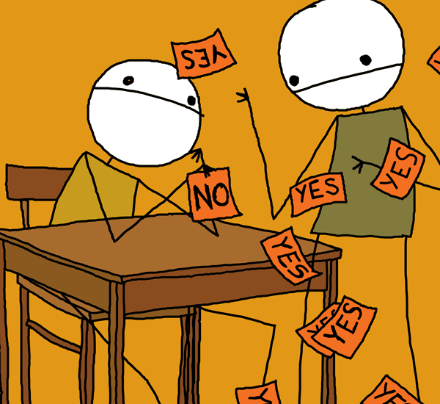
DECISION MAKING
How do the decisions we make everyday effect our GOALS?
How do we make decisions?
Notes:
1. Hang signs up around the room.
2. FORCED CHOICE GAME:
RULES:
Listen to the statements, and then find a spot around the room in order to make your choice. You MUST make a choice.
After forced choice discuss how people got to their decisions. What influenced them? Ask follow up questions.
-If you were influenced by someone
-If you felt alone or lonely in your choice
-When you HAVE to make a choice vs when you don’t know or care about something
-If you felt pressure to make a certain choice
-If you made a very different decision than anyone else – or if you didn’t why not?
3. Moving forward.. How does being mindful of our decision making process affect our goals?

Slide 7
CLOSING
HEAD: WHAT DID YOU LEARN?
HEART: HOW DID YOU FEEL?
FEET: WHAT ARE YOU GOING TO DO?
Notes:
DRAW A PERSON ON THE BOARD – have them write on the board their answers
Head, heart, feet –. Ask participants to think about three questions about the workshop – What did you learn? HEAD How did you feel? HEART What are you going to do? FEET. have them say their answers out loud. This activity is a way to evaluate participant’s thoughts and feelings.
PASS AROUND SIGN UPS FOR NEXT WORKSHOP SERIES/FAMILY WORKSHOP

