Slide 1
STRENGTHS 101
By the end of this workshop, you will be able to identify 5 of your greatest strengths! You will also begin thinking about how to apply these strengths to enrichment programming.

Slide 2
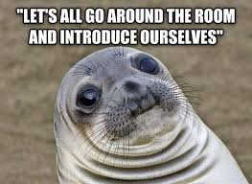
INTRO
WHAT IS OPPORTUNITY LAUNCH?
FOLDERS
TRACKER

Slide 3
A Shining Moment: Ice Breaker
Notes:
Divide the meeting participants into groups of four people by having them number off, one through four. Have your number ones sit with the other ones and so forth. (You do this because people generally begin a meeting by sitting with the people they already know best.)
Tell the newly formed groups that their assignment is to look back over their lives and find one event, activity, accomplishment, collaboration, or moment of recognition by others that were shining or important to them. I think of these as highlights. Provide ten or so minutes for the participants to think about and jot down ideas before you ask them to share their shining moments with their small group.
Ask them to share moments from classes, part time jobs, volunteer work, family life, or other out of school time.
Once participants have a chance to think about their shining moments, ask them to share them with their small group. My preference is that each person shares one at a time. Tell the small group members to look for common themes and similarities in the stories.
Tell the groups that each person will be asked to share one of their shining moments with the whole group upon completion of the small group exercise, if they are comfortable doing so.
Debrief the team building ice breaker by asking the group how they reacted to the ice breaker - to the experience of telling their own stories and hearing the stories of their friends.
Continue to debrief the ice breaker by asking the large group of participants noticed themes in the stories. Ask if participants found commonalities in the stories shared in the small or large groups. One theme that I often find mentioned is that the stories are all about receiving recognition.. Let your participants draw this conclusion; don't tell them. It generally sparks a discussion about the importance of recognition.
When the team building ice breaker discussion is finished, ask the participants if they have anything they'd like to add to the discussion before moving on with the rest of the session.

Slide 4
Brainstorm
How do we define strengths and weaknesses?
How do we feel when we’re involved in things that make us feel weak?
How do we feel when we’re involved in projects and activities that make us feel stronger?
Notes:
Write the answers on chart paper in a compare/contrast format.

Slide 5
What amount of time do you spend each day doing things that strengthen you? That you look forward to?
What is stopping you from spending more time on activities that make you feel stronger?
Notes:
Give them clock handout to fill in – use two different colors. One color is things that make you feel stronger and the other is things that do not. Let them discuss while doing this – what are your days filled with? School, homework, the internet, etc.

Slide 6
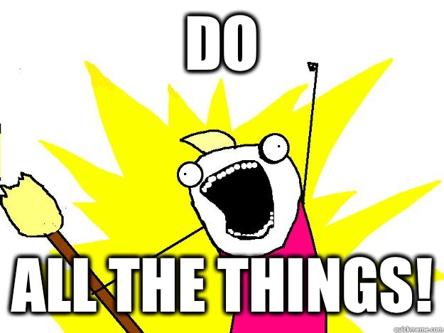
Organize Your Top Strengths
Highlight the strengths that speak to you the most – then put them in order of most to least
Notes:
Print out a list of 60 strengths/qualities – have students circle or highlight the top 5 strengths that speak to them/apply to them –then at the bottom put them in order of most applicable to least.

Slide 7
Narrow & Specify
Using your #1 word, complete the following worksheet!
Notes:
Handout – #1 Word, Who, What, When, Where, Why? This handout will help them brainstorm ways to play to their strengths more often. Allow time to talk with others to brainstorm activities and programs that might apply.
Now students have identified their strengths, narrowed their focus, and brainstormed how to play to their strengths.

Slide 8
Closing Activity
Notes:
Share around the room – everyone will state their #1 word, their topic, their population, AND if they signed up for the next workshop!!

